Slide 1


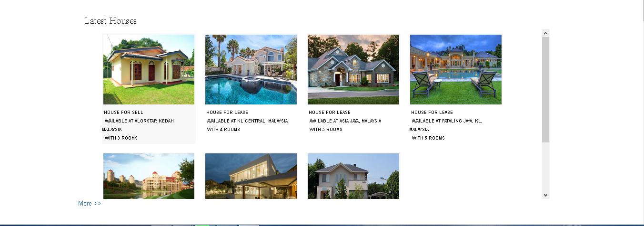

Property Management System your name B.Sc. Software Engineering– UC3F1410SE
Introduction
Methods
Conclusion
Property management is one significant business field in current era in which involves real estate and vehicle deals. The success factor of this business depends on the information sharing among public. There are many method being used to promote and advertise about properties for sale, further there have being many web based systems developed to support the process of property management, but all those conventional and new web systems contains limitations. Hence the developer has come up with a new product which is an online property management system, which can help to solve and fill the existing gaps in the domain of property management.
Data collection methods
Primary Research
Questionnaire
Observation
2. Secondary Research
Academic Journals
Periodicals
Patents
After conducting a thorough domain research on the property management field and the existing property management mechanism, the developer turned up with the notion of developing the property management system and redefine the traditional property management process and existing systems. As a result, the developer was able to come up with the system which covers most of the existing gaps in property management.
Property Management System
References
Benjamin, J. D., Jud, G. D. & Sirmans, G. S., n.d. What Do We Know About Real Estate Brokerage?. JRER, 20(1), p. 20.
Huffman, F. E. & Asabere, P. K., n.d. Price concessions, time on the market, and the actual sale price of homes. The Journal of Real Estate Finance and Economics, 6(2).
Urbanavičienė, V., Kaklauskas , A., Zavadskas, E. K. & Seniut, m., 2009. The web–based real estate multiple Criteria Negotiation decision support system: a new generation of decision support systems. International Journal of Strategic Property Management, Volume 13, p. 22.
Objectives
To investigate in different types of existing property management systems.
To reduce the time taken in selling and buying a properties.
To provide an opportunity for the vendors to approach their target customers.
To provide expert recommendations to the customers on any type of property purchasing.
Insert your text about the chart here.
Interesting info
Second note
Third finding

